Slide 1
Chi Square Statistical Analysis
Dr. Keller
Mr. Anderson’s Chi-Square: https://www.youtube.com/watch?v=WXPBoFDqNVk

Slide 2
Chi-square: to test how likely it is that an observed distribution is due to chance. A "goodness of fit" statistic, as it measures how well the observed distribution of data fits with the distribution that is expected.
When you collect data, is the variation in your data due to chance or is it due to something else?
(ex: is your genetics expected or different due to gene linkage)
Notes:
Gene linkage means that genes aren’t independently assorting therefore most likely on the same chromosome!

Slide 3
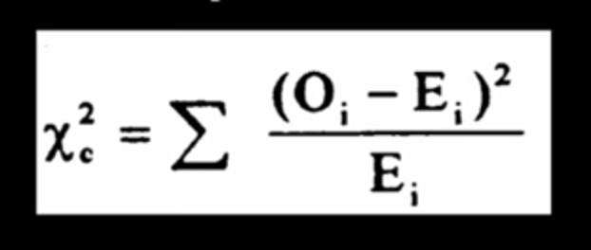
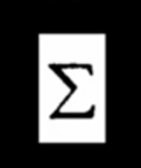

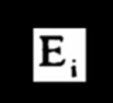
Sum
Observed Values (what you actually got!)
Expected Values (what Mendelian genetics expects based on the total numbers)

Slide 4
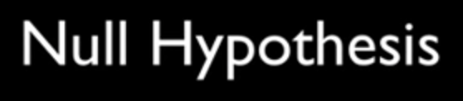
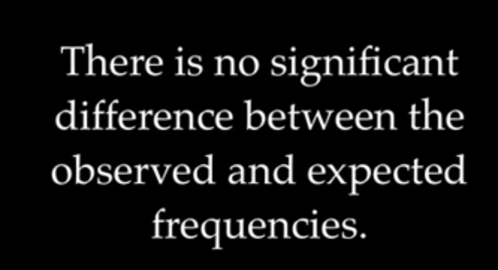
GOAL: REJECT OR ACCEPT THE NULL HYPOTHESIS
If you flip a coin 100 times.
You expect 50 heads and 50 tails (expected values)
You get 62 heads and 38 tails (observed values)
If you cross AaBb x AaBb → what is expected phenotypic ratio?
Notes:
AaBb x AaBb → expected ratio is 9:3:3:1 (# of outcomes is 4)
AaBb x AABb → expected ration is 6:2 → 3:1 (# of outcomes is 2)

Slide 5
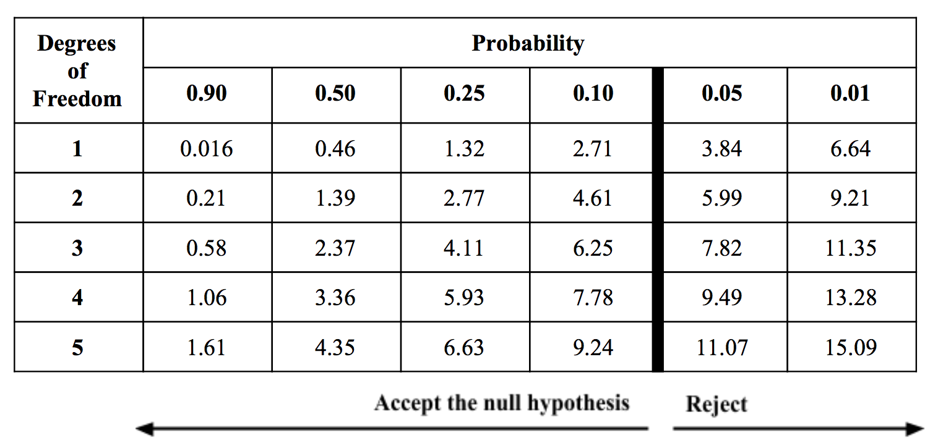
Degrees of Freedom: The degrees of freedom is the number of outcomes minus one.
Critical Values: We will use 0.05 value.
If your # < critical value = ACCEPT null hypothesis
If your # > critical value = REJECT null hypothesis (there is something going on!)

Slide 6
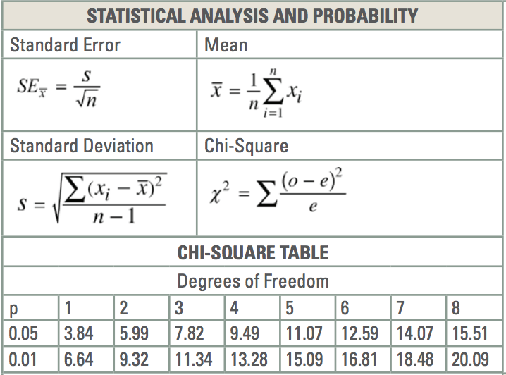
I will provide you the same as the AP Biology test
You will likely only be asked to calculate
between two gropus (Df = 1). Same on my test!

Slide 8
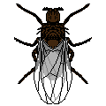


Let’s try an example dihybrid Drosophila cross
(determine genotypes of the parents – you can assume that they are both true-breeding)
x
Black body - eyeless
Wild type (normal body color; red eyes)
F1: all wild type
Notes:
bbee x BBEE
F1: BbEe x BbEe

Slide 9
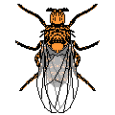


F1 CROSS PRODUCED THE FOLLOWING OFFSPRING
5610
1881
Wild type
Normal body - eyeless
1896
622
Black body
Black body - eyeless

Slide 10
NOW CONDUCT THE ANALYSIS:
Null hypothesis: The two traits (black body and eyeless) are NOT linked and therefore randomly segregate & assort independently of each other during gamete formation. The differences between the expected values and observed values are due to chance alone.

Slide 11
ANALYSIS OF THE RESULTS:
Once the total number of offspring in each class is counted, you have to determine the expected value for this dihybrid cross.
What are the expected outcomes of this typical dihybrid cross? ________
____ should be wild type
____ should be normal body eyeless
____ should be black body wild eyes
____ should be black body eyeless.
Notes:
9:3:3:1 (what are each phenotype?)

Slide 12
NOW CONDUCT THE ANALYSIS:
To compute the expected value multiply the expected 9/16:3/16:3/16:1/16 ratios by total number (10,009)

Slide 13
CALCULATING EXPECTED VALUES:
To calculate the expected value:
Multiply the total number of offspring times the expected fraction for each phenotype class
TOTAL = 10,009
Normal eyes and normal bodies expected value: 9/16 x 10,009 = 5630
Eyeless and normal bodies expected value: 3/16 x 10,009 = 1877
Normal eyes and black bodies expected value: 3/16 x 10,009 = 1877
Eyeless and black bodies expected value: 1/16 x 10,009 = 626

Slide 14
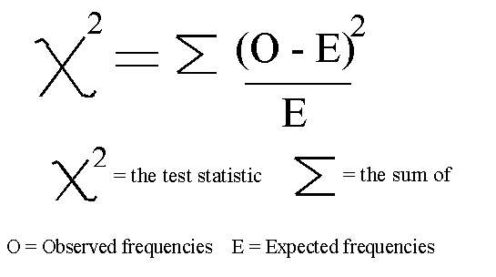
CALCULATING X²:
Using the chi square formula compute the chi square total for this cross:
(5610 - 5630)² / 5630 = 0.07
(1881 - 1877)² / 1877 = 0.008
(1896 - 1877)² / 1877 = 0.19
(622 - 626)² / 626 = 0.03
x² = 0.298
How many degrees of freedom?
4 phenotype classes – 1 = 3 degrees of freedom

Slide 15
Critical Values: We will use 0.05 value. Meaning you are 95% sure that you are either rejecting or accepting our null hypothesis.
If your # < critical value = ACCEPT null hypothesis (observed and expected are not different)
If your # > critical value = REJECT null hypothesis (there is something going on)
Using the chi square formula compute the chi square total for this cross:
x² = 0.298 with 3 degrees of freedom
The p-value in the chart above is 7.82, which is MORE THAN our calculated 0.298 so we ACCEPT the null hypothesis that the observed and the expected are NOT significantly different!

